Slide 1


Mentor-Mentee Connect Portal
Project Guide- Dr. Juhi Singh
By:-
Meetul Singh

Slide 2
Introduction
The Mentor-Mentee Appointment website is an innovative solution designed to streamline the process of scheduling appointments between students and teachers.
With this platform, students can easily schedule appointments with their teachers and get the academic support they need to succeed.

Slide 3
Objective
The objective of this project is to design and develop a user-friendly interface for students and teachers to schedule appointments with their mentors at the university using HTML, PHP and MYSQL database.

Slide 4
Aim
The aim of your project is to develop a teacher-student appointment system to improve the appointment scheduling process for students and teachers at the university.

Slide 5
Features
Login: Allow users to login to the website with their email address and password.
Appointment Scheduling: Allow students to schedule appointments with their teachers by selecting the teacher, date and time. Teachers can approve, reject, or reschedule appointments.
Availability Management: Allow teachers to set their availability and schedule for appointment times, including the duration and mode of the appointments.
Notification System: Notify users of upcoming appointments, changes in appointment status, and other important information related to their account and appointments.

Slide 6
Methodology

Slide 7
Front End
The front end of our portal is developed using HTML and CSS for giving structure and style to the portal along with Bootstrap which is the leading CSS framework for developing responsive and mobile-first websites.

Slide 8
Backend
The technology stack used for backend is PHP with MYSQL database (XAMPP).
XAMPP makes it easy to set up a MySQL database on your local machine for testing and development purposes. Install XAMPP with just a few clicks, and then start using MySQL immediately.
PHP has built-in support for MQSQL database.
PHP is used to execute queries and interact with the database. PHP code is used to connect to the MySQL database, send queries to the database, and retrieve data from the database. PHP also allows developers to create forms and handle user input, which can then be stored in the MySQL database.

Slide 9
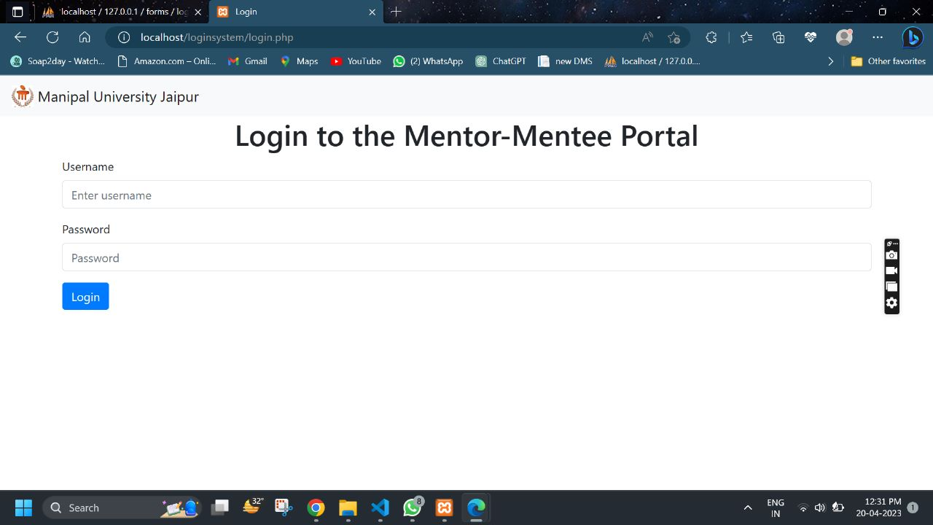
LOGIN PAGE

Slide 10
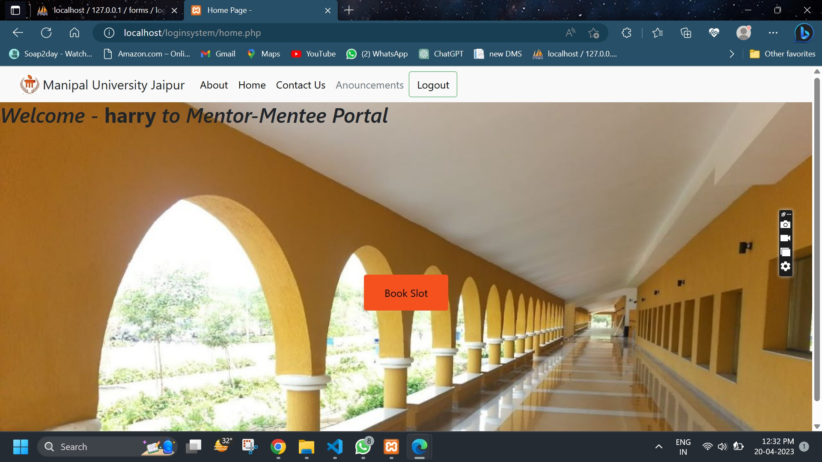
HOME PAGE

Slide 11
DEPARTMENT WISE TEACHERS LIST

Slide 12
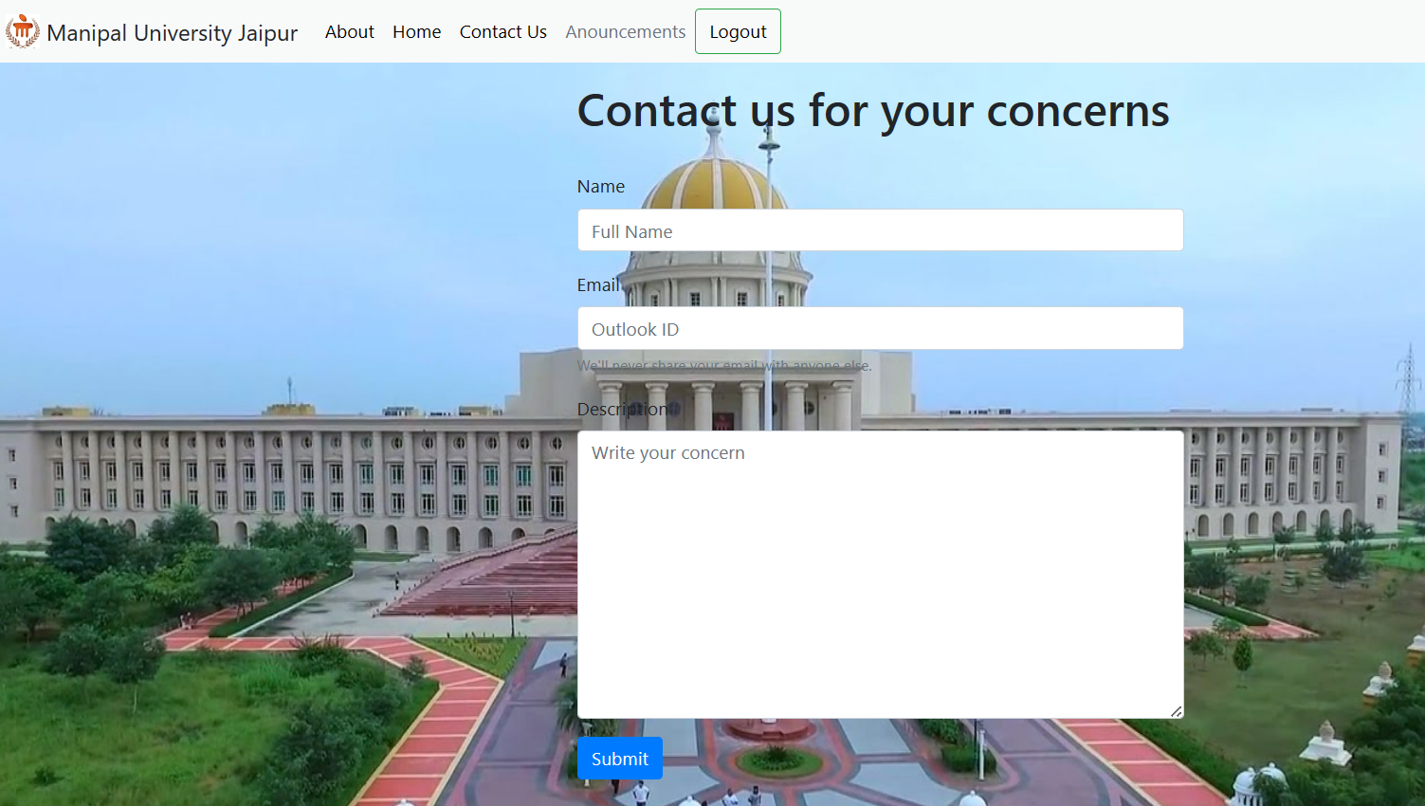
CONTACT US PAGE

Slide 13
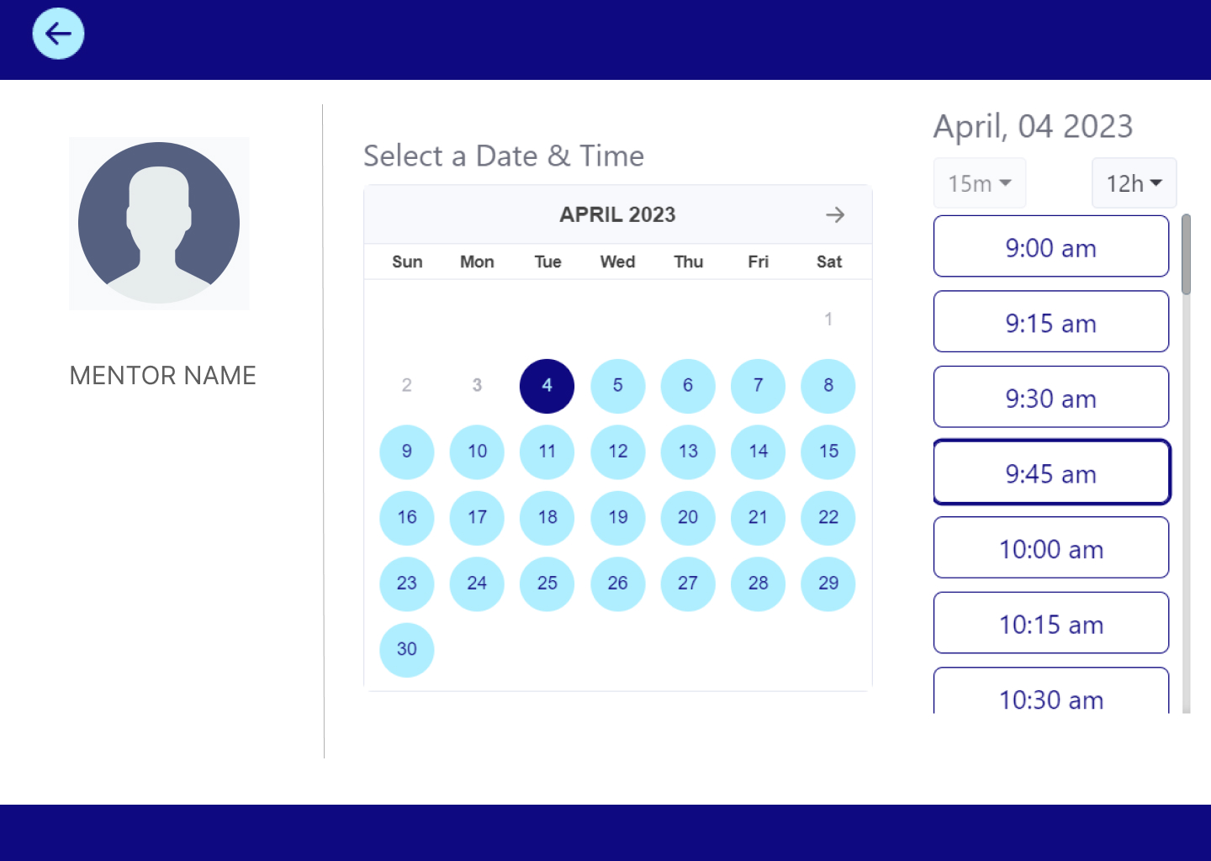
SLOT BOOKING PAGE

Slide 14
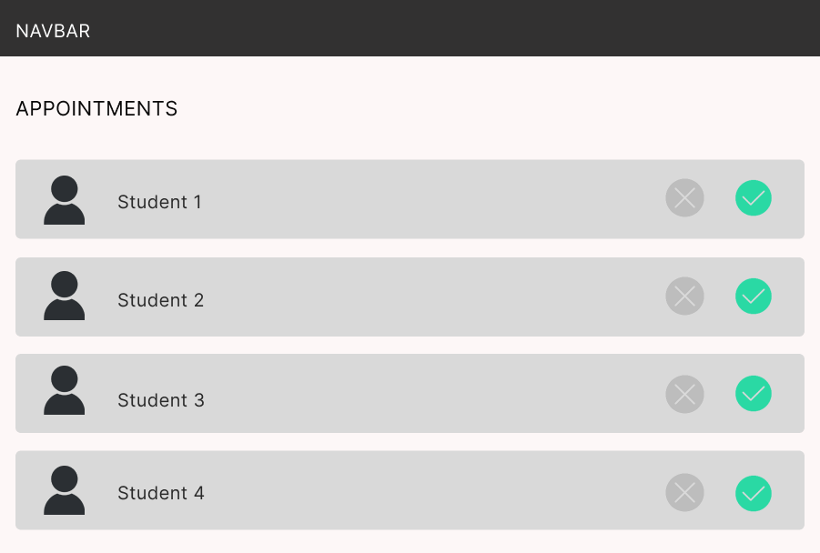
PENDING APPOINTMENTS (ACCEPT/REJECT)

Slide 15
Future Scope
Real-time communication: A chatting feature would allow students and teachers to communicate with each other in real-time, making it easier to get immediate answers to questions or discuss details related to appointments.
Integration with Calendar: Integrate the website with popular calendar tools, such as Google Calendar or Outlook Calendar, to allow users to easily manage their appointments and schedules.
Automatic Reminders: Send automatic reminders to users before their appointments to reduce the risk of missed appointments.
Cancellation Policy: Establish a cancellation policy to help manage missed or cancelled appointments.

Slide 16
Thank You

